Slide 1



MERN – ES6 + React
Module: 12 ES6 - II

Slide 2
Outline
Module: 12 ES6 - II
Understand concepts of methods Array Function map()
Understand concepts of methods Array Function reduce()
Understand concepts of methods Array Function: filter()
Understand concepts of methods Array Function: find() and findIndex()
Understand concepts Classes in ES6
Understand concepts of Inheritance in ES6
Understand concepts Working with Promises

Slide 3

Array Function map()

Slide 4
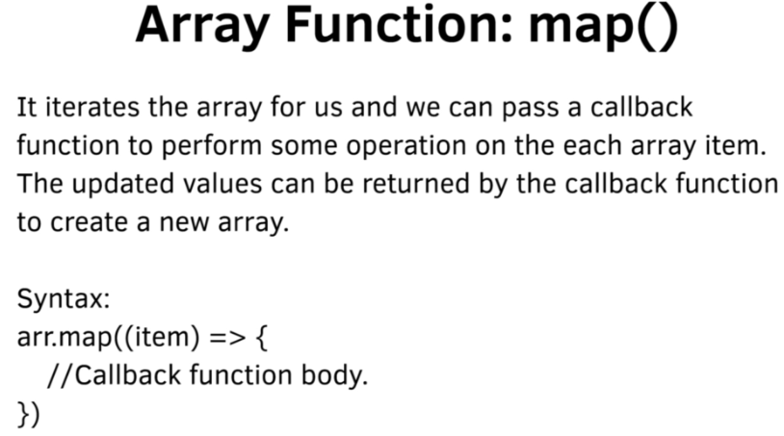

Slide 5
Array Function reduce()

Slide 6
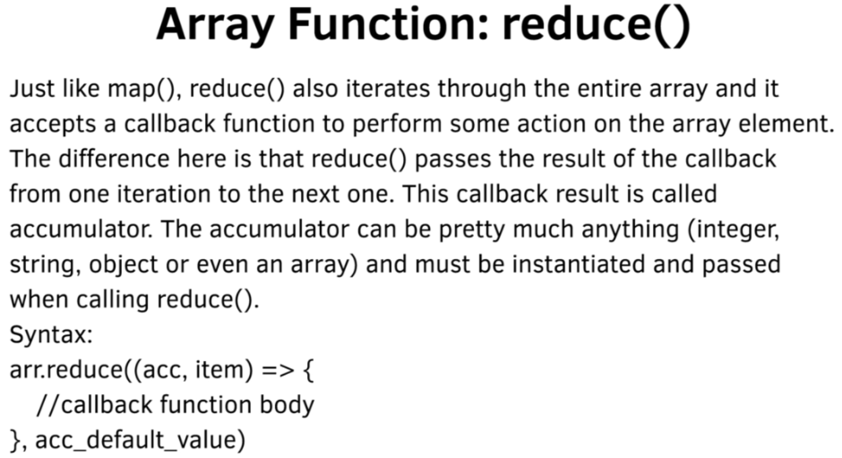
xczx

Slide 7
Array Function: filter()

Slide 8
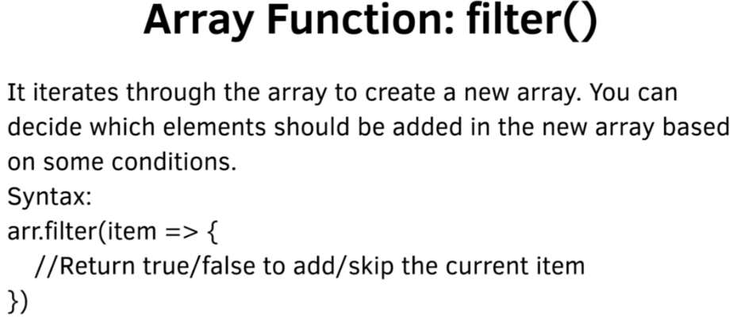
xczx

Slide 9
Array Function: find() and findIndex()

Slide 10
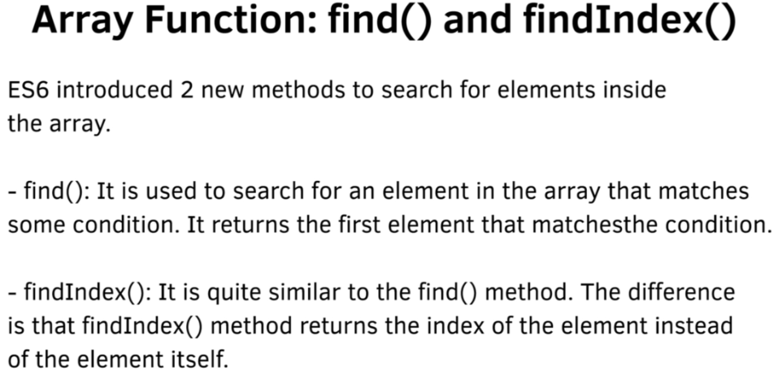

Slide 11
Classes in ES6

Slide 12
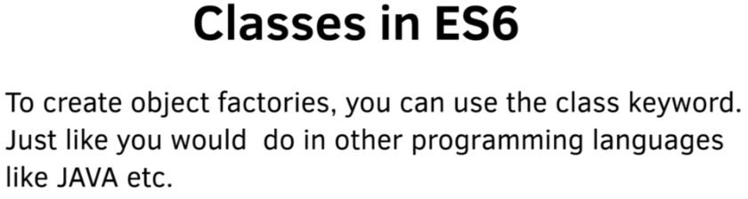

Slide 13
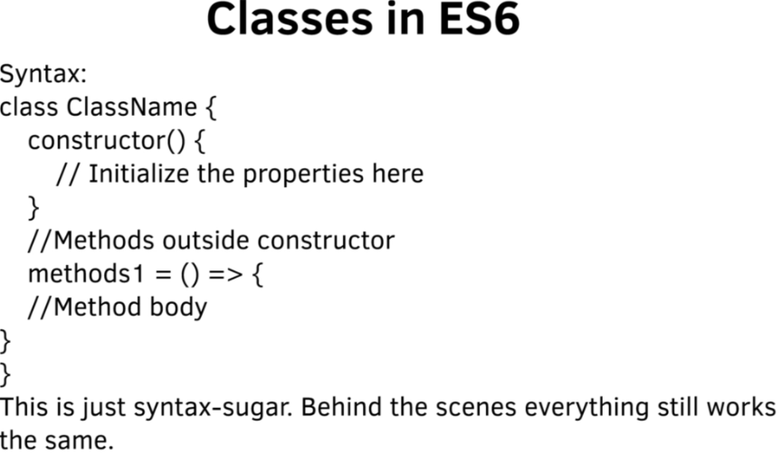
Classes in ES6

Slide 14
Inheritance in ES6

Slide 15
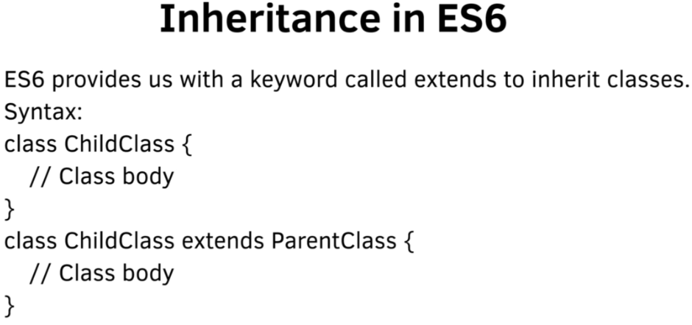

Slide 16
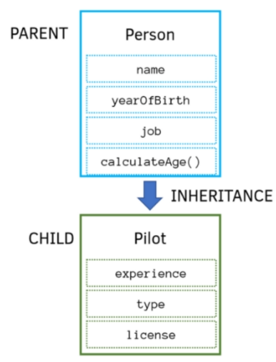

Slide 17
Working with Promises

Slide 18
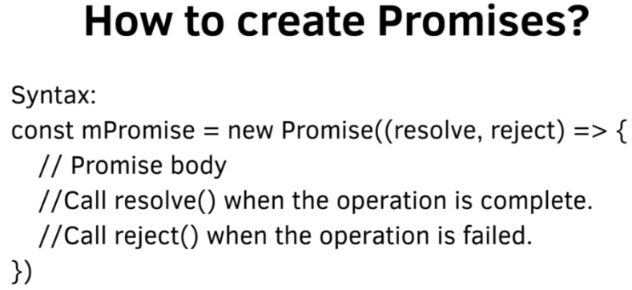

Slide 19
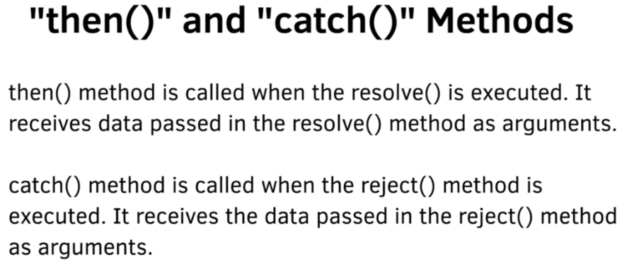

Slide 20
Callbacks and Promises

Slide 21
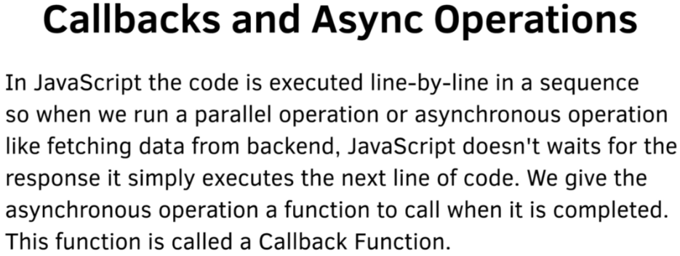

Slide 22
Introduction to Promises

Slide 23
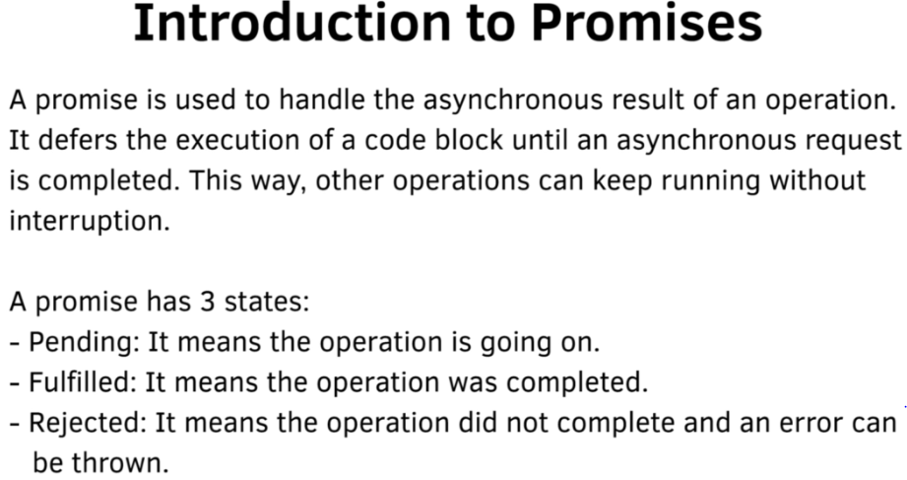

Slide 24
Summary
Module: 12 ES6 - II
Understand concepts of methods Array Function map()
Understand concepts of methods Array Function reduce()
Understand concepts of methods Array Function: filter()
Understand concepts of methods Array Function: find() and findIndex()
Understand concepts Classes in ES6
Understand concepts of Inheritance in ES6
Understand concepts Working with Promises

